Slide 1
SCHOOL PTCA
MACAILAO, MARIA CRISTINA B. II-12 BVE

Slide 2
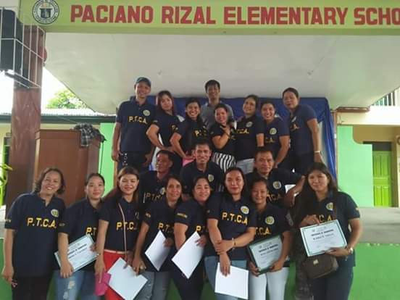
ANO ANG PTCA?
Ang Parents Teachers Community Association o PTCA ay isang samahan sa bawat paaralan na kinabibilangan ng mga guro, magulang at namumuno sa komunidad na naglalayon sa pagsasama-samang tulungan at paggawa para sa kapakanan ng mga-aaral at pamilyang kanilang kinabibilangan.
Asuan, et.al (2001). Edukasyon sa Pagpapahalaga: Buhay, Para sa Kolehiyo. PNU Centinnial

Slide 3
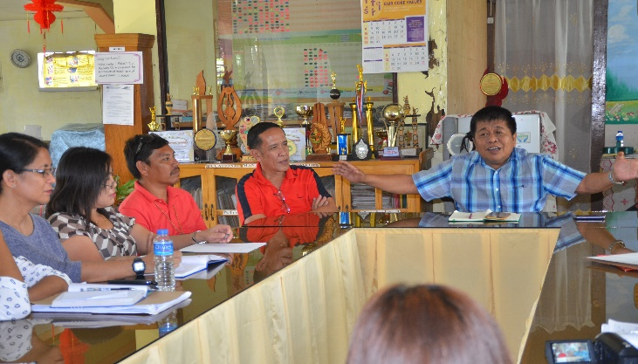
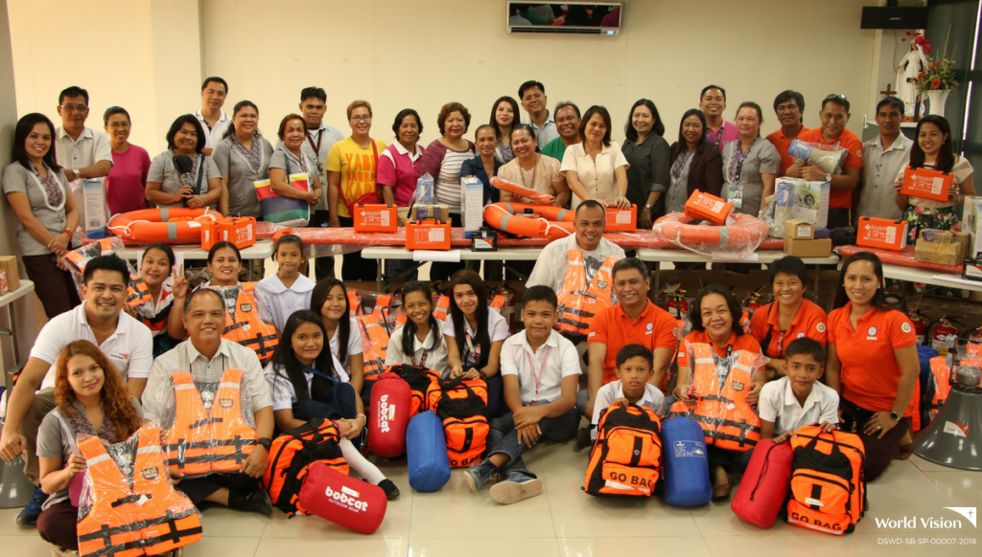
LAYUNIN AT GAWAIN NG PTCA:
Pagkakaroon ng mga programa at proyekto na kasasangkutan ng paaralan at pamilya.
Bigyan ng kalutasan ang mga suliraning kinakaharap ng mga mag-aaral sa paaralan at kanilang pamilya.
Potable Water System, Sanitation Priority Projects Initiated In Makilala Elementary Schools
Child-focused disaster risk reduction and management:
Journeying with Tagbilaran City Schools

Slide 4
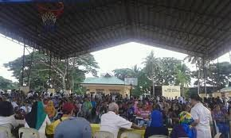
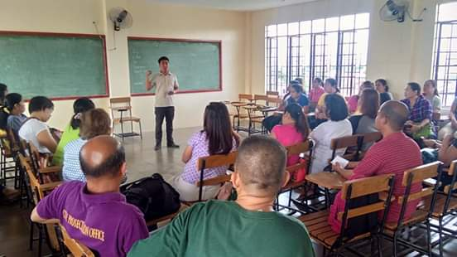
PROYEKTO PARA SA PAMILYA
Pangunahan ang pagkakataon na magkasama-sama ang pamilya: field trips o fund-raising projects.
GENERAL ASSEMBLIES
FIELD TRIPS

Slide 5
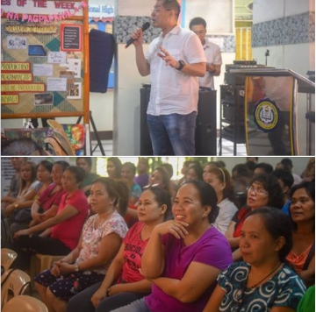
PROYEKTO PARA SA PAMILYA
Parental Drug Education seminar sa Potrero National High School, kasama ang Malabon Anti-Drug Abuse Council at Philippine National Police, nagbahagi ng impormasyon sa mga magulang at mag-aaral ng PNHS.
Ø Pag anyaya sa mga makapagbibigay ng kaalaman tungkol sa epektibo at responsableng pagmamagulang para sa mga magulang gayundin naman para sa mga guro na tumatayong pangalawang magulang sa paaralan.

Slide 6
QUESTIONS FOR A PTCA OFFICER:
1. Why did you decided to join the PTCA?
2. What PTCA projects directly benefit the family?
3. Are parents active in PTCA? What could be the reason?
4. Why should there be a partnership among PTCA?
5. Can you give a message to teachers and parents regulating PTCA?

Slide 7
Pagkakaroon ng mga programa at proyekto na kasasangkutan ng paaralan at pamilya.
Organisasyon na naglalayon sa pagsasama-samang tulungan at paggawa para sa kapakanan ng mga-aaral at pamilyang kinabibilangan.
Bigyan ng kalutasan ang mga suliraning kinakaharap ng mga mag-aaral sa paaralan at kanilang pamilya.
SCHOOL PTCA
Solusyon:
Mga karaniwang aktibidad:
komunikasyon
Mahabang pag-unawa
Respeto
kooperasyon
Mga karaniwang suliranin:
General assemblies
Fieldtrips
Family days
seminars
Kawalan ng suporta
Kawalan ng komunikasyon

Slide 8
LOCAL | INTERNATIONAL
SCHOOL PTCA
News Update
DepEd, PTA work for the improvement of education services The Department of Education Abra Schools Division Office encourages parents to actively participate in school governance for the improvement of the delivery of basic education services during the first general assembly for school year 2019-2020. PTA as a support group of the school is also the voice of the parents. Issues and concerns can be discussed and resolved during PTA meetings. | Back to School: PTA/parents involvementBy CONNOR FOARDE , Aug 2, 2019 “Parental involvement enhances a children’s educational experience by making them aware of what the child is doing within the classroom and those same ideals can be expanded while at home.,” Colvin said. “It also gives the child the feeling of importance and pride when their parents take a vested interest in what they do thus setting the example of the importance of education.”
Reference:June 10, 2019 abranewsdesk R. (2019, June 10). DepEd, PTA work for the improvement of education services. Retrieved October 12, 2019, from | Reference:Foarde, C. (2019, August 2). Back to School: PTA/parents involvement. Retrieved October 12, 2019, from
Research Findings
Level of Parent Involvement in the Elementary and Secondary Levels Denmark Yonson Philippine Normal University Findings implies that regardless of level, the parents show the same amount of eagerness to participate and perform whatever duties are required of them by the organization for the improvement of their children and of the school community. | ENHANCING PARENT INVOLVEMENT:Guidelines for Access to an Important Resource of School Administrators Nancy Feyl ChavkinDavid L. Williams, Jr Southwest Educational Development Laboratory The result clearly indicates that administrators and parents have strong interest in parent involvement in education.
Reference: Hornby, G. (2011). Parent Involvement in Elementary Schools. Parental Involvement in Childhood Education, 43–59. doi: 10.1007/978-1-4419-8379-4_4 | Reference: Chavkin, N. F., & Williams, D. L. (1987). Enhancing Parent Involvement: Guidelines for Access to an Important Resource for School Administrators. Journal of College Student Retention: Research, Theory & Practice, 19(2), 107–120.

Slide 9
MEDIA AND TECHNOLOGY
MACAILAO, MARIA CRISTINA B. II-12 BVE

Slide 10
MEDIA AND TECHNOLOGY
Modern media and technologies made the adolescents to spend many hours in accessing to internet, cell phones, smartphones, video games and other kind of modern technologies.
This became a primary concern that affected their important social interactions that develop in-person relationships including the family (Ebrahem, 2016).

Slide 11
SOCIAL MEDIA
POSITIVE:
· Medium of social interaction, communication and entertainment.
· Used to get attached from people who were far away from us.
NEGATIVE:
· Communication starts to diminish.
· Used for posting emotions and problems.
· Parents and children don’t have personal conversations anymore.
Brazil, L., Duque, G., San Antonio, D. (2017) A Correlational Study on Social Media Involvement and Parental Relationship among Students of Asia Pacific College. De La Salle University

Slide 12
VIDEO/ONLINE GAMES
POSITIVE:
· Getting everyone together to play can promote family bonding and unity.
· Families who tend to be physical inactive may also benefit from playing video games by choosing games like boxing, which can promote physical activity.
NEGATIVE:
· Playing video games too often can promote isolation and seclusion and can cut down on your family time and communication.
· Playing violent video games may also lead to increased violence and aggression in family members.
Modern Mom. (n.d). The Effects of Video Games on the Family. Retrieved from: https://www.modernmom.com/2daee054-051f-11e2-9d62-404062467d7e.html

Slide 13
TELEVISION
POSITIVE:
Watching television together could enhance family relationships
Television can be used to educate, inform, and even bring families together.
Can be used in pointing out positive behaviour, such as cooperation, friendship, and concern for others and making connections to history, books, places or interest and personal events.
NEGATIVE:
Watching TV at mealtime is a distraction and makes it difficult for family members to engage in conversation, therefore resulting in the prevention of important family connections that are made at mealtime.
Television can temporarily divide family rather.
Children learn information from television that may be inappropriate or incorrect.
Television exposes children to behaviours and attitudes that may be overwhelming and difficult to understand.
Notes:
Villegas, Alessondra (2013) "The Influence of Technology on Family Dynamics,"Proceedings of the New York State Communication Association: Vol. 2012, Article 10.

Slide 15
Local | International
MEDIA AND TECHNOLOGY
News Update
Study reveals internet can ruin family relationships(Philstar.com) - August 2, 2016 - 5:29pm Researchers surveyed over 3,700 families in seven countries to know about how the internet is affecting their personal relationship with their children.One in four of the parents surveyed say that their kids now prefer to go online rather than talk to them, with one in three parents believing the internet isolates them from their children. All in all, a fifth of parents and children say that the internet can cause family tension. | Digital media helps with parenting and brings families togetherTUE 06 FEB 2018The Parenting for a Digital Future report, launched on Safer Internet Day 2018, disputes the popular anxiety that digital media destroys family life by separating family members. Rather than displacing established ways of interacting, the report finds that digital media sits alongside them.
Reference: Study reveals internet can ruin family relationships. (n.d.). Retrieved from | Reference: London School of Economics. (2018, February 6). Digital media helps with parenting and brings families together. Retrieved October 12, 2019, from
Research Findings
A Correlational Study on Social Media Involvement and Parental Relationship Among Students of Asia Pacific College Gelzalis Duque, Diosah Nina San Antonio, and Leonora Brazil Asia Pacific College, Magallanes, Makati City Based on the findings, social media does not always bring harm to teenagers and to the people around them. Furthermore, this will be more convenient to them to maintain connection and contact to their parents when they are not around. | Parental Perceptions of the Role of Media and Technology in their Young Children’s Lives Brigitte Vittrup, Sharla Snider, Katherine K Rose, and Jacqueline Rippy Texas Woman’s University, USA One-third of the parents indicated that they would not allow their child to have a television in the bedroom, but another 56 percent had already granted this to their children. One-fifth of these children also had their own cell phone. Given the young age of these children, the amount of private access to media technologies may be worrisome.
Reference: A Correlational Study on Social Media Involvement and ... (n.d.). Retrieved October 12, 2019, from | Reference: Vittrup, B., Snider, S., Rose, K. K., & Rippy, J. (n.d.). Parental perceptions of the role of media and technology in their young children's lives - Brigitte Vittrup, Sharla Snider, Katherine K Rose, Jacqueline Rippy, 2016. Retrieved from

Slide 16
CHURCH-MASS/SERVICE,
BIBLE STUDY, ETC.
CLAIRE ANTONETTE ACEDERA

Slide 17
I. GAMPANIN NG SIMBAHAN SA PAMILYA
Ang simbahan ay naglalayong ipaalam sa tao ang katotohanan ng mga aral at doktrina ukol sa Diyos.
Ang pamilya ang nagsisilbing gabay upang mapanatili ng pamilya ang pamumuhay at pag-uugnayan nang may pagmamahalan.
Ang simbahan din ang ay isang maingat na tagapagbantay na tumutuligsa sa mga salik at maaaring makasira sa pagsisilbihan ang pamilya ayon sa kaayusan na nais ng Diyos.
Ninanais ng anumang paniniwala o relihiyon na maikintal sa bawat pamilyang kasapi nila ang mga sumusunod: matibay at tapat na pagsasama ng mag-asawa, mapanagutang pagmamagulang, pagkakaisa at pagmamahalan bilang tanda ng magandang ugnayang miyembro ng pamilya, pagtuturo ng mga pagpapahalaga tungo sa kabutihan at pagpapanatili sa dignidad at kapakanan ng pamilya.

Slide 18
GAWAIN O AKTIBIDADES NG SIMBAHAN
Katoliko
Couple of Christ at Marriage Encounter- samahan na parehong naglalayong mapagtibay ang samahan ng mag-asawa. Ang samahang ito ay matatagpuan sa parokya ng simbahan upang makatugon sa pangangailangang ispiritwal at moral ng mag-asawa. Sama-samang pinagninilayan ng mga mag-asawang kasapi ang mga salita ng Diyos sa pamamagitan ng pagbabasa ng Bibliya.

Slide 19
GAWAIN O AKTIBIDADES NG SIMBAHAN
2. Iglesia ni Cristo
Ang samahang tinaguriang Bukluran ay itinatag sa paglalayong maingatan ang bawat pamilya ng Iglesia ni Cristo. Ipinapaalam sa pastor ang suliranin o sigalot ng pamilya kapag ito ay lubhang masalimuot at di kayang lutasin ng may tungkulin.

Slide 20
GAWAIN O AKTIBIDADES NG SIMBAHAN
3. PROTESTANTE
Ang Family Day/ Retreat ay ang araw na itinakda para sa pagkakatipon-tipon ng mag kasapi ng samahang ito. Nakalaan ang espesyal na araw na ito upang sama-samang manalangin, magpuri, mag-awitan at magkasayahan ang pamilya para sa Panginoon.
Samantala ang Everybody’sWedding Anniversary ay isang gawaing naglalayong lalong mapag alab ang pagmamahalan ng mag asawa tuwing buwan ng Pebrero.

Slide 21
INTERVIEW QUESTIONS FOR BARANGAY
Ano po ang inyong tungkulin bilang isa sa mga namumuno sa inyong nasasakupan?
Ano po ang mga Gawain na maaari ninyong matulong sa bawat pamilya na inyong nasasakupan?
Epektibo po bang naisasagawa ang mga Gawain ng barangay na may kinalaman sa pamilya? Sa paanong paraan?
Gaano kaaktibo ang pamilya sa barangay?
Ano naman po ang mga dapat gampanan ng pamilya upang makatulong sa barangay?
Bakit po kinakailangan na magkaroon ng ugnayan ang pamilya at barangay?
Ano ang inyong mensahe para sa aming mga guro sa hinaharap

Slide 22
Gampanin ng barangay na mapanatiling maayos, mapayapa ang kanyang nasasakupan.
BARANGAY
Feeding Program
Clean Up Drive
Pagsunod sa mga batas na ipinatutupad ng barangay.
Pakikipag-ugnayan sa mga Gawain ng barangay.

Slide 23
Local |  | International
Church Mass/ Services/ Bible Study
News Updates
Dip in church attendance feared to weaken family tiesPublished April 19, 2017, 2:07 PMBy Christina I. Hermoso Former Ambassador to the Vatican Henrietta De Villa has expressed concern over a Social Weather Station (SWS) survey that showed a decline in Sunday mass attendance among Filipino Catholics in recent years. | Marriage Research: Attending Church Together Strengthens RelationshipJim Liebelt - Contributing Writer A recently released study suggests that couples who attend church together regularly have a higher level of relationship satisfaction than couples who do not.
Reference: Rowe, N. A. (n.d.). Making my faith my own: church attendance and first-year college student religious and spiritual development. Retrieved from | Reference: Schleifer, C., & Chaves, M. (2016). Family Formation and Religious Service Attendance. Sociological Methods & Research, 46(1), 125–152. doi: 10.1177/0049124114526376
Research Findings
Making my faith my own: church attendance and first-year college student religious and spiritual development Neil Alan Rowe For some first-year college students, attending church is an expression of freedom and personal power to be an agent in their own religious and spiritual development. Students not attending church services or a campus ministry conserved their spirituality through science and nature and through public and community service and being a good person. | Family Formation and Religious Service Attendance: Untangling Marital and Parental Effects Cyrus Schleifer and Mark Chaves Married people attend religious services significantly more frequently than unmarried people, and those with more children attend more frequently than those with fewer children.
Reference: Rowe, N. A. (n.d.). Making my faith my own: church attendance and first-year college student religious and spiritual development. Retrieved from | Reference: Schleifer, C., & Chaves, M. (2016). Family Formation and Religious Service Attendance. Sociological Methods & Research, 46(1), 125–152. doi: 10.1177/0049124114526376

Slide 24
BARANGAY –
COMMUNITY SERVICE
CLAIRE ANTONETTE ACEDERA

Slide 25
WHAT IS BARANGGAY?
The barangay government unit is composed of elective officials called the Punong Barangay who is the chief executive, the Sangguniang Barangay members, also called Kagawads, and the Sangguniang Kabataan Chairman. The appointive officials are the barangay Secretary, the barangay Treasurer, the members of the Lupong Tagapamayapa, and the barangay Tanods.

Slide 26
THE BARANGAY STRUCTURE AND GENERAL FUNCTIONS
1. Punong Barangay
The Punong Barangay, as the chief executive of the Barangay government, shall exercise such powers and perform such duties and functions, as provided by this Code and other laws.
2. Sangguniang Barangay
The Sangguniang Barangay, the legislative body of the Barangay, shall be composed of the Punong Barangay as presiding officer, and the seven (7) regular Sangguniang Barangay members elected at large and Sangguniang Kabataan chairman, as members.

Slide 27
THE BARANGAY STRUCTURE AND GENERAL FUNCTIONS
3. Barangay Secretary
The Barangay secretary shall be appointed by the Punong Barangay with the concurrence of the majority of all the Sangguniang Barangay members. The appointment of the Barangay secretary shall not be subject to attestation by the Civil Service Commission.
4. Barangay Treasurer
The Barangay Treasurer shall be appointed by the Punong Barangay with the concurrence of the majority of all the Sangguniang Barangay members. The appointment of the Barangay treasurer shall not be subject to attestation by the Civil Service Commission.

Slide 28
THE BARANGAY STRUCTURE AND GENERAL FUNCTIONS
5. Barangay Assembly
There shall be a Barangay assembly composed of all persons who are actual residents of the Barangay for at least six (6) months, fifteen(15) years of age or over, citizens of the Philippines, and duly registered in the list of Barangay assembly members.
6. Lupong Tagapamayapa
There is hereby created in each Barangay a Lupong Tagapamayapa, hereinafter referred to as the lupon, composed of the Punong Barangay as chairman and ten (10) to twenty (20) members. The lupon shall be constituted every three (3) years in the manner provided herein.

Slide 29
THE BARANGAY STRUCTURE AND GENERAL FUNCTIONS
7. Sangguniang Kabataan
A Sangguniang Kabataan official who, during his term of office, shall have passed the age of twenty-one (21) years shall be allowed to serve the remaining portion of the term for which he was elected.

Slide 30
BARANGGAY ACTIVITIES
Developmental Planning
Peace and Order
Good Governance
Environmental Management
Welfare of senior citizens, family and persons with disabilities and other members of the marginalized sectors
Disaster risk reduction and management
Agriculture and fishery development
Physical fitness and sports development
Employees/workers welfare
Health and sanitation
Ethics and Public Morals

Slide 31
INTERVIEW QUESTIONS FOR CHURCH
Ano po ang Gawain ng inyong relihiyon para sa pamilya?
Ano po ang inaasahan ng inyong relihiyon sa bawat pamilyang kasapi nito?
Naisasabuhay po ba ng mga kasaping pamilya ang turo ng inyong relihiyon? Patunayan.
Ano ano ang maaaring maging resulta kapag aktibo at di-aktibo ang pamilya sa simbahan o relihiyong kinabibilangan? Bakit?
Ano po ang mensahe niyo sa pamilyang Pilipino?
Ano po ang inyong mensahe para sa aming mga guro sa hinaharap?

Slide 32
Gampanin ng barangay na mapanatiling maayos, mapayapa ang kanyang nasasakupan.
BARANGAY
Feeding Program
Clean Up Drive
Pagsunod sa mga batas na ipinatutupad ng barangay.
Pakikipag-ugnayan sa mga Gawain ng barangay.

Slide 33
Local | International
Barangay/Community Service
News Update
Community health centers to launch mental health services: DOHABS-CBN NewsPosted at Jan 24 2019 05:06 PM Basic mental health services may now be accessed through community health centers after the implementing rules and regulations (IRR) of the Mental Health Law was signed earlier this week. | Family and Community Services close cases on children at riskJOANNE McCARTHYFEBRUARY 19 2015 - 10:30PM HUNTER Family and Community Services offices are routinely closing serious alleged child abuse cases due to ‘‘competing priorities’’ and overwhelmed support services, documents obtained by the Newcastle Herald have shown.
Reference: News, A. B. S.-C. B. N. (2019, January 24). Community health centers to launch mental health services: DOH. Retrieved October 12, 2019, from | Reference: McCARTHY, J. O. A. N. N. E. (2015, February 19). FACS close cases on children at risk. Retrieved from
Research Findings
Productivity and Performance of Barangays: The Case of the Heritage City of Vigan, Philippines Edelyn Alicar-Cadorna The barangays in the Heritage City of Vigan were strong in terms of resource requirements which make possible the production of goods and services in the barangays. They also complied with the budgetary requirements imposed on personal services. They had adequate serviceable equipment, and maintain a one-day processing time for issuing barangay related certificates.However, the barangays lacked a manual of operations and they lacked serviceable vehicles.
Reference: Productivity and Performance of Barangays: The Case of the ... (n.d.). Retrieved from https://pdfs.semanticscholar.org/1a44/ddb49293057100340b416146790158975d09.pdf.

Slide 63
Local |  | International
Service Vocation
News Update
Social media, clergy ‘big factors’ in vocations promotions A local seminarian believes social media and clergy support is proving crucial for vocations promotions success. According to Sem. John Harvey Bagos, “advertisements [on] social media” and “the wave of support of the parish priests” are key factors in promoting vocations among the youth. |  | In Rochester, moms' group prays for vocations to come from among their familiesBy Michelle La RosaRochester, N.Y., Oct 6, 2019 / 04:06 pm (CNA). A newly-formed group of Catholic mothers in Rochester, New York has committed to praying regularly for the flourishing of vocations from within their own families. They pray for their kids, for their vocations, to hear God’s call, what He’s asking of them.
References: Social media, clergy 'big factors' in vocations promotions. (2019, May 6). Retrieved October 12, 2019, from |  | Reference: Cna. (2019, October 6). In Rochester, moms' group prays for vocations to come from among their families. Retrieved October 12, 2019, from
Research Findings
Goin’ Solo: A Study on Singlehood and Views on ‘Sologamy’ in the Contemporary Philippine Society On singlehood and relationships in the contemporary Philippine society. The interviews with respondents confirmed that many of the traditional expectations and stigmas associated with single people continue to have a hold in Philippine society particularly affected were the female respondents, who are expected to marry and bear children. | Understanding Singlehood from the Experiences of Never-Married Malay Muslim Women in Malaysia: Some Preliminary FindingsRozita Ibrahim & Zaharah HassanNational University of Malaysia (UKM), Malaysia The analysis of the interview transcriptions reveals four major themes in understanding the meaning of singlehood from the experiences and reflections of Malay Muslim women perspective. They are (1) centrality of the notion of ‘jodoh’ (soul-mate as fated by God) in explaining the reasons for being single, (2) single women are aware of their stigmatised status and acknowledge feelings of inadequacy, (3) family members and friends are important as their social support system, and finally (4) singleness is also seen in positive light as opportunity towards self-enhancement.
Reference: Cabalza, C. (n.d.). Goin' Solo: A Study on Singlehood and Views on 'Sologamy' in the Contemporary Philippine Society. Retrieved from | Reference: https://scholar.google.com/scholar?hl=en&as_sdt=0%2C5&q=understanding+single+hood&btnG=#d=gs_qabs&u=%23p%3DPBGYTB0p4o4J

Slide 64
A Message to the Family

Slide 65
A Message to Family
Catholic | Iglesia ni Cristo
Pope Francis on the Importance of Family 1. Say These Three Words. PleaseThank youSorry. 2. Do the Little Things. 3. Keep Dreaming! 4. Make Time to Play. 5. Pray Together. 6. Accept Your Imperfections. 7. Be Patient. 8. Look to Our Elders. 9. Set an Example. 10. Light the Way. Mother Teresa on the Importance of Family Love begins at home, Mother Teresa insisted when she was alive. Home and family are the twin tutors in love, compassion, patience, and service. | A Blessed and Victorious Family No parent would want to fail in rearing a child. True success in family life is not measured by riches or wealth. Parents should not only teach but also show how to live with integrity . The important role of the parents is to teach childrens the obedience to the 10 commandments of God. Parents should always be reminded to teach their children to be prayerful and attend the worship services. Reference:

Slide 66
Born Again Christian
There are a number of parallels between fathering a family and fathering a church. Both require: 1.) Training and teaching the whole counsel of God. 2) Wielding authority. 3) Exercising compassionate love. 4) Disciplining 5) Having flexibility. Enduring hardship. 7) Persevering. 8) Being a mentor. 9) Fostering independence. Spending time with people. | Shepherding Your Family (John 10:1-18) By studying Jesus’ words, we can learn seven principles for shepherding our families. To shepherd your family, make sure that you’ve entered through the door, and then lead your children through the door, who is Christ (10:9). To shepherd your family, work at knowing them on an individual basis (10:3-5, 14) To shepherd your family, you must set the example (10:4). To shepherd your family, you must lead them to the pastures of God’s Word (10:9-10). To shepherd your family, you must guard them from danger (10:10-13). To shepherd your family, you must serve them (10:11, 15, 17-18). To shepherd your family, tenderly care for each one, even if he or she is not being especially lovable (10:12-13) Reference: Lesson 13: Shepherding Your Family (John 10:1-18). (n.d.). Retrieved from https://bible.org/seriespage/lesson-13-shepherding-your-family-john-101-18.

Slide 67
Muslim
Families are considered to be at the heart of every Muslim community. Family life was created by Allah to keep society together and Muslims should follow the example of the Prophet Muhammad, who was married and raised a family Roles of men and women. Islamic law and practice recognise the differences between the sexes, resulting in different roles and obligations for men and women. Men, therefore, are regarded as protectors of women and families, and providers of financial support. Women are expected to have children and to fulfil the role of wife and mother. Protection and nurturing Many Muslims believe that family life is the foundation of human society providing a secure, healthy and nurturing environment for parents and growing children. The family unit should encourage the individual to see themselves as part of a wider community and should discourage anti-social behaviour. Caring for the elderly Muslims treat the elderly with dignity. | Parenting and children Muslim parents have a responsibility to care for their children physically and emotionally. Children are expected to respect their parents. Your Lord has commanded that you worship none but Him and that you be kind to your parents. If one of them or both of them reach old age with you, do not say to them a word of disrespect… and act humbly to them in mercy.Qur'an 17:23-24 Children and spiritual development The mother is at the heart of the Muslim family and is responsible for teaching children about halal and haram in the home. The father is responsible for taking the children to the mosque. Importance of Family "The person who severs the bond of kinship will not enter Paradise." Family is a critical component of Muslim life, and keeping with pre-Islamic sensibilities, ties among extended family are encouraged. Expectations of Parents Parents are expected to provide for their children, be kind to them and raise them as Muslims. Expectations of Children Being dutiful to parents includes being obedient, kind and respectful. Reference: https://www.pasugo.com.ph/a-blessed-and-victorious-family/

Slide 68
Interview Questions “Pope's Letter to the Family”
Para po sa inyo, ano ang tunay na kahulugan ng pamilya?
Ano - ano po ba ang dapat na isinasaalang alang na pagpapahalaga sa loob ng pamilya?
Sa tingin niyo po, mahalaga po ba ang gampanin ng simbahan sa pag gabay sa bawat miyembro ng pamilya?
Ano po ba ang tunay na gampanin ng ama, ina, at anak sa loob ng pamilya.
Sa iyong palagay, Paano po mapapagtibay ang samahan at komunikasyon sa isang pamilya?
Bilang isang leader ng simbahan, ano po ang iyong maiipapayo sa bawat pamilyang Pilipino?

Slide 70
Local | International
Popes Letter To the Family
News Update
Pope Francis and family planning12:01 AM July 12, 2016 Parenthood is about being responsible. This is clear that the Pope suggests three children are about right, which is the same proposal President Duterte made. | Pope urges families build a better future through stronger prayer lifeCatholic News ServiceAug 2, 2019CONTRIBUTOR Pope urges families build a better future through stronger prayer life
Reference: INQUIRER.net. (n.d.). Pope Francis and family planning. Retrieved October 12, 2019, from | Reference: Pope urges families build a better future through stronger prayer life. (2019, August 2). Retrieved October 12, 2019, from

